Slide 1
Quantexa Solution Architect Final Interview
Solution Architect Hire Zhong Lun, Jan 2023
Version 1

Slide 2
The Problem
Largest Singapore media company
They have aggregated their media content for past 20+ years and built up a platform to commercialize it
IP tracking done manually

Slide 3
The Scope (Functional)
IP Tracking will crawl “Singapore” company web sites: public and private portals
IP Tracking will crawl English text content
to support other languages in future
to support other contents such as photos
Each web page will be considered and compared as only on article
Frontend to facilitates the user in investing and managing infringement cases

Slide 4
The Scope (Non-Functional)
Web sites to crawl
Digital content from the customer
6-month to implement
support growth in next 5 years

Slide 5
The Challenges
Highly scalable, highly customized crawler
Highly scalable, highly customized index and search engine
Infringement detection algorithm
Input:
Digital content to be pre-processed and indexed
Seed list

Slide 6
The Challenge (infringement detection algorithm)
Resiliency: precisely detect the similarity between modified and original
Similarity level: section, chapter, paragraph, …
Modification: insert/delete something
Format: i.e. text => PDF or PDF => text
“web noise”: header, footer, navigation, ads, javascript, …
Accuracy
false positive error: fail to detect the similar pair
false negative error: fail to detect the non-similar pair
Scalability
Implementation Cost

Slide 7
Infringement Algorithm (Signature)
Min- hashing
Locality-
sensitive
Hashing
Candidate pairs:
those pairs of signatures that we need to test for similarity.
Shingling
Doc
The set of strings
of length k that appear in the document
Signatures:
short integer vectors that
represent the
sets and
reflect their
similarity
Shingling: (Andrei Broder) convert document into sets
Minhashing: (Edith Cohen, Broder) construct small signatures for sets so Jaccard similarity of sets can be determined from the signatures.
Locality-Sensitive Hashing: (Rajeev Motwani, Piotr Indyk) focus on (likely) similar pairs without looking at all pairs.

Slide 8
Infringement Algorithm (Fingerprint)
Extract
minutiae
and
discretize
Locality-
sensitive
Hashing
Candidate pairs:
those pairs of fingerprints that we need to test for similarity.
Fingerprint
Optional
minhashing
here
Shingling: (Andrei Broder) convert document into sets
Minhashing: (Edith Cohen, Broder) construct small signatures for sets so Jaccard similarity of sets can be determined from the signatures.
Locality-Sensitive Hashing: (Rajeev Motwani, Piotr Indyk) focus on (likely) similar pairs without looking at all pairs.

Slide 9
The Solution

Slide 10
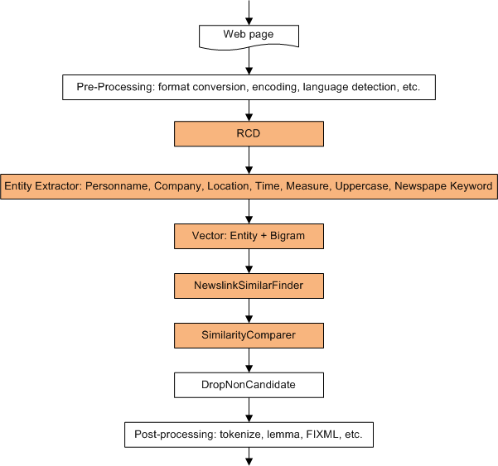
The Solution (the pipeline)
Notes:
RCD: Related Candidates Detector (for entity detection)

Slide 11
The Solution (SimilarFinder)
Purpose: to narrow down the no. of documents for comparing and make sure they are highly similar.
This is achieved by:
high quality vector
minimum rank score
maximum no. of return documents

Slide 12
The Solution (SimilarFinder)
Document Vector: a set of (string, weight) pairs.
Find Similar = Find Documents with Similar Vector
IP Tracking Vector: Bigram + Entity
Entity - given more weight to:
personname
company
location
time
numeric
uppercase
newspaper Keywords: Zaobao, Straits Times, My Paper, etc.

Slide 13
The Solution (SimilarityComparer)
Notes:
A quantitative way to defining that two objects are similar is to use a similarity function. The similarity function measures degree of similarity between two objects and will return a value in [0, 1].
The Jaccard coefficient measures similarity between sample sets, and is defined as the size of the intersection divided by the size of the union of the sample sets:
Jaccard(A, B) = |A v B| / |A ^ B|
Containment score: entities in A / entities in B A – original content
B – content from infringement web site

Slide 14
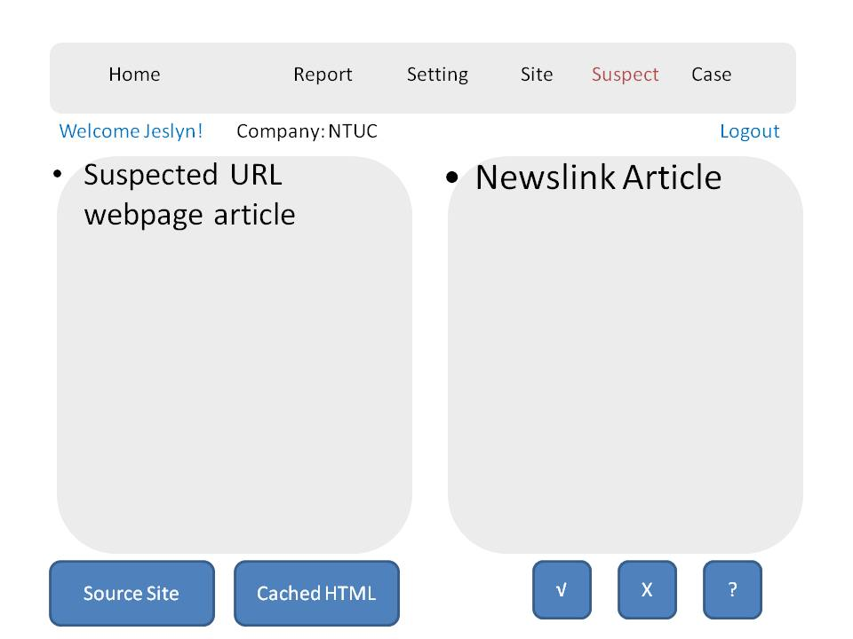
UI: Suspect

Slide 15
UI: Report

Slide 16
UI: Site

Slide 17
UI: Crawler

Slide 18
Outcomes
Highly praised and saved manpower (20+ → 2)
Best practice for infringement detection
What I learn:
Clearly understanding what to deliver
Share challenges with the customer
Build a modular and scalable solution
Technically identify and track the uncertainties

